Slide 1

What is The MLC?
Notes:
This presentation will give you an overview of the Mechanical Licensing Collective – otherwise known as The MLC
[Do not read this note aloud]
The copyright in this presentation is owned by The MLC and is made available to educators who have specifically requested access to The MLC’s Educator Toolkit, to use in their classes and for presentations about The MLC made to their campus community. This PowerPoint file may NOT be shared with students or posted on a Learning Management System.

Slide 2
Presentation Overview
The MLC’s Purpose
Copyright Basics
Mechanical Licenses and How to Get One
How the MMA Changed Mechanical Licensing
The Digital Royalties Landscape and The MLC
Membership in The MLC
Mechanical Royalties
Historical Unmatched
Notes:
[Read the slide]

Slide 3


The MLC’s Purpose
DSPs in U.S.
Sound Recordings Only Interactive Streams
Limited Downloads
Permanent Downloads
Musical Works Rightsholders
Music Publishers
Publishing Administrators
Self-administered writers
Ex-U.S. CMOs
CERTAIN TYPES OF DIGITAL SERVICE PROVIDERS
RIGHTSHOLDERS
The MLC is the EXCLUSIVE administrator of the new blanket digital mechanical license
Notes:
The MLC plays a key role in an important type of revenue in the music industry.
A type of royalties called digital mechanical royalties flow into and out of the MLC
They flow from certain types of digital service providers and flow to certain types of rightsholders
Let’s dig a bit deeper [trigger more animation]
The MLC collects mechanical royalties from digital service providers, operating in the U.S., that make Sound Recordings of musical works available via interactive streaming, limited downloads and permanent downloads.
The MLC then pays the parties who are entitled to receive the royalties, including music publishers, publishing administrators, self-administered writers, and mechanical rights organizations based outside of the U.S. (referred to as CMOs)
The MLC is the only organization authorized to collect and distribute the royalties paid pursuant to the new blanket mechanical license created by the Music Modernization Act
We are going to dive much deeper into all of this, but let’s start by discussing a few copyright law basics

Slide 4


Copyright Basics: Musical Works and Sound Recordings
Songs or Compositions
Recordings
(Copyright law calls these MUSICAL WORKS )
Created by:
Songwriters or Composers and Lyricists
Often administered by:
Music Publishers
The music (a melody, rhythm, and/or harmony that could be expressed in a system of musical notation) and the words (lyrics) if any
(Copyright law calls these SOUND RECORDINGS)
Created by:
Recording Artists and Producers
Often distributed by:
Record Companies
The recording of sounds.
A Sound Recording is not the same as an Audiovisual Work (video)
Example: The song “Yesterday” was co-written by John Lennon and Paul McCartney
Example: The song “Yesterday” was first performed and recorded by The Beatles, but numerous other artists subsequently performed and recorded (or “covered”) this song, including Elvis Presley, Aretha Franklin, and Frank Sinatra
Notes:
Before you can understand what mechanical licensing is, you need to understand a bit about the copyright law
There are two types of works that copyright law protects which are involved in mechanical licensing
The first is the song (sometimes called a composition). The U.S. copyright law calls these musical works
These are created by songwriters or composers and lyricists, and often administered by music publishers
A Musical Work is the music (the melody, rhythm, and/or harmony that could be expressed in a system of musical notation, and the words (lyrics) if any
For Example: The song “Yesterday” was co-written by John Lennon and Paul McCartney
The other type of work is a Recording. The copyright law calls these sound recordings
These are created by Recording Artists and Producers, and typically distributed by Record Companies
These are essentially the recording of sounds.
Note that a Sound Recording is not the same as an Audiovisual Work (video)
For Example: The song “Yesterday” was first performed and recorded by The Beatles, but numerous other artists subsequently performed and recorded (or “covered”) this song, including Elvis Presley, Aretha Franklin, and Frank Sinatra. This is one of the most covered songs of all time.

Slide 5








Copyright Basics: Rights and Revenue
©
MUSICAL WORK EXCLUSIVE RIGHTS
REPRODUCE
DISTRIBUTE
PUBLICLY
PERFORM
PUBLICLY
DISPLAY
PREPARE DERIVATIVES
Sheet Music
CDs and Vinyl Records
Interactive Streams
Downloads
Live Performances
Terrestrial Radio (FM)
Interactive Streams
Non-interactive Streams
Lyrics on Karaoke screen
Synchronization
Sample (Interpolation)
Remix
MECHANICALS
Notes:
The U.S. copyright law gives owners of musical works five exclusive rights.
The right to reproduce the work, distribute the work, publicly perform the work, publicly display the work, and prepare derivatives of the work
Different uses of music involve one or more rights under the copyright law
[Show just the 4 under the first two rights] These examples here all involve the reproduction and distribution of a musical work.
[Show the dotted outline of the three examples under the first two rights and the yellow arrow] In the U.S., when we refer to a mechanical license, we are talking about permission to reproduce and distribute musical works in sound recordings which are then included in physical products such as CDs and vinyl records, interactive streams and downloads
[Show the yellow box around the two examples under the first two rights and The MLC logo] The MLC is only involved in digital mechanical licensing and royalties.
We will explain the difference between an interactive stream and a non-interactive stream on the next slide.
Note how this type of use is different from publicly performing [show examples] or displaying [show example],or preparing a derivative [show examples] of the work.

Slide 6











Mechanical Licenses
Examples of reproductions and distributions of
musical works in audio-only physical and digital records (phonorecords)
DIGITAL RECORDS:
INTERACTIVE STREAMING
& LIMITED DOWNLOADS
PHYSICAL RECORDS:
VINYL AND CD
DIGITAL RECORDS:
PERMANENT DOWNLOADS
Notes:
A mechanical license is needed in order to reproduce and distribute a musical work as a sound recording in audio-only physical and digital records, what the copyright law calls phonorecords and digital phonorecords
The first example of a phonorecord is physical records such as a vinyl record or CD.
The second example is a permanent download. These involve the consumer buying a file, downloading it and keeping it permanently.
The third example are interactive streaming and limited downloads. An interactive stream is one where the consumer has control over which recording to stream on a digital services. It is sometimes called on-demand streaming. A limited download is where a download to a device happens but it is only accessibly in a limited way, such as for a limited number of plays or a limited time. One example of this is when a consumer picks a setting in their favorite streaming app to have their playlist available for offline listening, which is what happens when the device is not connected to the internet. For licensing purposes, limited downloads are categorized together with interactive streaming. Some examples are services like Spotify, Apple Music, Amazon Music, and Pandora Premium, which is a different service from Pandora Radio. Pandora Radio only involves non-interactive streaming where the consumer can pick a channel or station or playlist, but cannot pick the specific recording to listen to. Non-interactive streaming services, which are essentially digital radio, do not require mechanical licenses, but do require other types of licenses.

Slide 7
Mechanical Licenses
HOW DO YOU GET A MECHANICAL LICENSE?
VOLUNTARY
LICENSE
COMPULSORY LICENSE
Obtained from the
Copyright Owner or Administrator
of the work
Copyright Owner or Administrator
can decide
whether or not to grant a license
If it is available, obtained by adhering
to the procedures set out in the
U.S. Copyright Law §115
Copyright Owner or Administrator
cannot prevent
the granting of a license
License terms including royalty rates are negotiated
License terms are set by statute or federal regulation
Royalty rates are set by the Copyright Royalty Board
There are several different compulsory licenses that exist in the U.S. Copyright Law in addition to this one
Notes:
So how does someone get a mechanical license? There are two ways.
One way is to obtain a voluntary license.
To do this, the party needing the license would contact the copyright owner or administrator of the work. And they can decide whether or not to grant a license
The parties would negotiate the terms of the license including the royalty rate and how often royalties are paid
The other way is to obtain a compulsory mechanical license if one is available.
To do this, the party seeking a license has to review the criteria established in the law to see if the musical work and intended use is eligible, and if it is, they have to adhere to the procedures set out in the copyright law, in section 115, and federal regulations. In this case, the copyright owner or administrator cannot prevent the granting of the license – the law grants the license
The license terms are set by statute or federal regulation. The royalty rates are set by the Copyright Royalty Board, a three-judge panel established to do exactly this sort of thing. There are several different compulsory licenses that exist in the U.S. copyright law.

Slide 8
Before the Music Modernization Act
Who
Record Companies (CD and Vinyl Records, and Permanent Downloads)
Digital Service Providers (Interactive Streams and Limited Downloads)
What
Work-by-work mechanical license
  In practice, more like share-by-share basis
How
(Plan A) Try to secure a voluntary mechanical license
(Plan B) Secure a compulsory license if the musical work is eligible
  §115: Eligible after the musical work has been distributed in phonorecords (physical or digital), in the U.S., to the public for their private use, with permission from the musical work copyright owner
Issues
No public authoritative database of musical works ownership information
Work-by-work licensing is not scalable – requires licensor to conduct extensive research for each work
Not all Musical Works rightsholders were receiving
their mechanical royalties from the digital service providers
Notes:
The Music Modernization Act of 2018 (or MMA for short) was a very important change to the U.S. copyright law.
One of the key things that it changed was how mechanical licensing for digital uses of music works is done.
To understand what it changed and why we needed the change, you need to first understand how things worked before the MMA
Before the MMA, record companies and digital service providers sought mechanical licenses for uses of musical works on physical products and permanent downloads, and for interactive streams and limited downloads.
They sought a mechanical license on a work-by-work basis. They had to secure a separate license for each musical work they intended to use, and in practicality, they sought mechanical licenses from each co-owner of a share of each musical work.
The way they did this was to first try to secure a voluntary license. If that was not available, they would look to see if the work was eligible for a compulsory license
In both cases, they had to research who owned or administered the copyright and request a license or serve notice that they were relying on the compulsory license
This research could be difficult because there was no public authoritative database of musical works ownership information. And with tens of thousands of tracks uploaded to services every day, this solution was not scalable.
This was not working well. Not all musical works rightsholders were getting paid their digital mechanical royalties and services were getting sued. Nobody was happy.

Slide 9
Music Modernization Act of 2018
Title I: Musical Works Modernization Act
Changes to §115
Blanket License |  | Eligibility |  |  |  | Public Database
Created a Blanket Compulsory Mechanical License for Interactive Streaming Limited Downloads Permanent Downloads |  | Expanded the compulsory license eligibility criteria for Digital Service Providers |  | Mandated the creation of a mechanical licensing collective to administer the new Blanket license |  | Mandated that The MLC establish and maintain a publicly available musical works ownership database
Notes:
The Music Modernization Act of 2018 changed things
The Act was made of up three titles, the first of which deals with mechanical licensing and is called the Musical Works Modernization Act
It created a Blanket Compulsory Mechanical License for interactive streaming, limited downloads, and permanent downloads
It expanded the compulsory license eligibility criteria
It mandated the creation of a mechanical licensing collective to administer the new blanket license
And it mandated The MLC establish and maintain a publicly available musical works ownership database

Slide 10
Changed by the Music Modernization Act
Who
Digital Service Providers (U.S. DSPs operating Interactive Streaming and Download services)
What
Blanket mechanical license
  Only need to obtain one blanket license for all eligible musical works
  Work-by-work voluntary licenses remain an option
How
Secure a compulsory license if the musical work is eligible
  §115: Does not have to previously been reproduced and distributed to the public – if the record company obtains a first use mechanical license from the copyright owner(s) and allows DSP to distribute their recording, that is enough
Notes:
After the MMA, the mechanical licensing activities of digital services providers changed.
Now those providers only need to obtain one license, the blanket license, and not a license for each individual work, although the voluntary license is still an option.
The eligibility was also expanded so that the compulsory license is available even if the work has never been reproduced and distributed before. The record company continues to have a responsibility to secure a voluntary mechanical license granting it permission for the first use of a musical work in a sound recording in phonorecords, (that has not changed), but once that happens and the record company gives the DSP permission to reproduce and distribute its sound recording, then the work is eligible for the DSP to distribute pursuant to the blanket compulsory license even if the work had never been distributed previously.

Slide 11

The New Blanket License
Applies to:
Audio only
Digital Mechanical Uses of Musical Works
  Interactive Streams
  Limited Downloads
  Permanent Downloads
DSPs operating in the U.S.
Does NOT Include:
Physical Mechanical Uses (e.g., CDs, Vinyl)
Video Streams or Video Downloads
Public Performance
Use of Lyrics
Non-Interactive Streams
(e.g., Satellite, Internet Radio)
Uses outside of the U.S.
Notes:
Let’s talk about the new blanket license.
The new license only grants permission for audio-only digital mechanical uses of musical works in the United States
That includes interactive streams, limited downloads, and permanent downloads
And only applies to DSPs operating in the U.S.
The license does not apply to mechanicals for physical products such as CDs and vinyl, video streams or downloads, public performance of musical works, the use of lyrics, or non-interactive streams. It also does not apply to uses outside of the U.S.

Slide 12
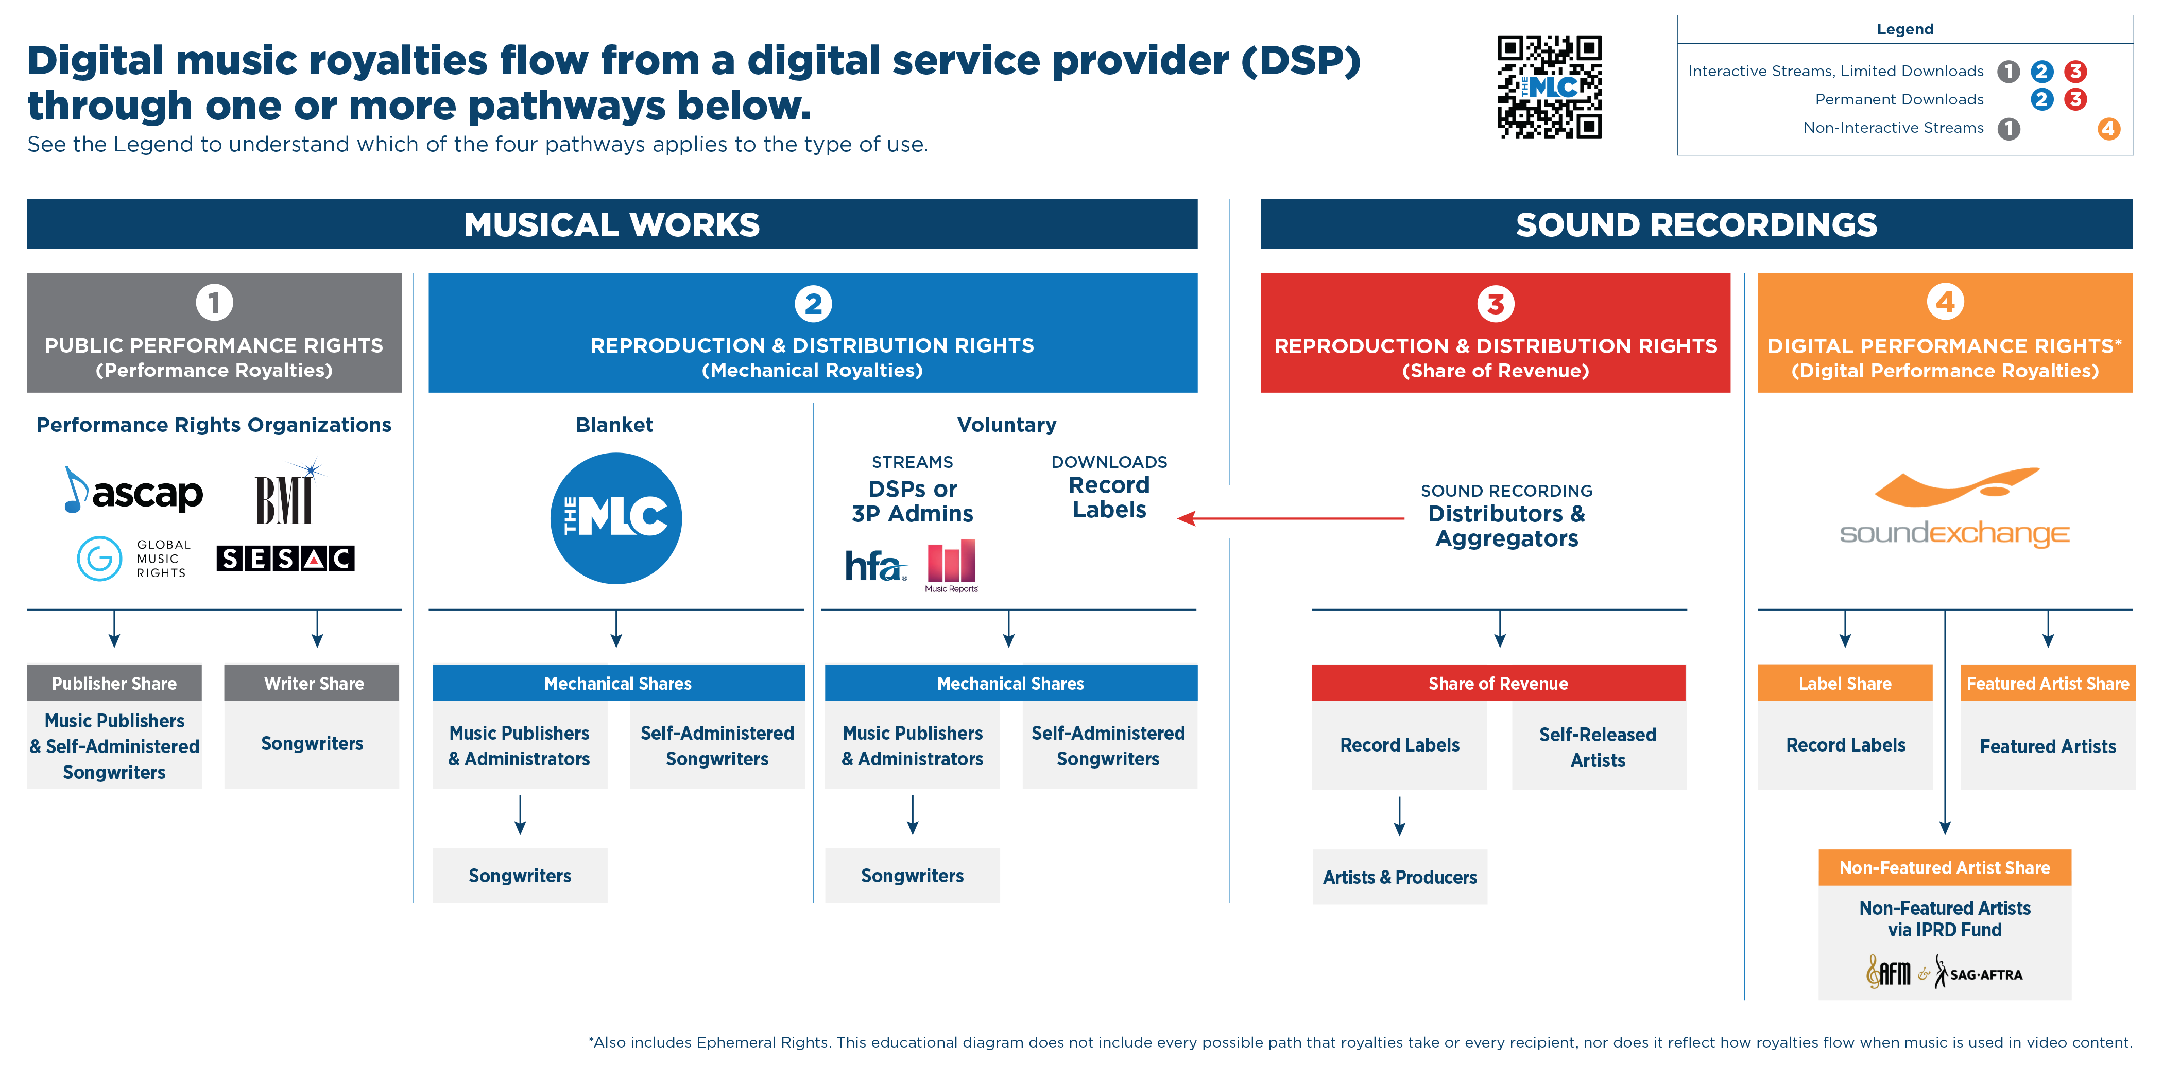
Digital Music Royalties Landscape
Notes:
In order to understand what the MLC does, it can be helpful to see where it fits in the digital music royalties landscape.
This diagram is on the MLC website under the Resources section
The first thing to look at is the Legend at the top right. It lists the different digital uses and then indicates which of the four columns, each representing a type of royalties, are generated by that use. Note the colors and numbers, 1-4.
For example, for an interactive stream, there are three types of royalties created, involving column 1, 2, and 3.
The left side of the screen describes royalty flows related to use of musical works, and the right side royalty flows related to the use of sound recordings
The yellow column, #1, is for public performance of musical works, and that is where you find PROs listed (performing rights organizations)
The blue column, #2 is for the reproduction and distribution of musical works in recordings (in other words, mechanicals), and that is where you find the MLC
The red column, #3, is for the reproduction and distribution of sound recordings, and that is where you find record distributors and aggregators listed
The orange column, #4, is for the digital public performance of sound recordings, and this is where you find SoundExchange listed.
A key take away from this slide is that The MLC is not replacing the parties in the other royalty flows. It is an addition to the landscape, not replacing other organizations.
In the #2 mechanicals flow, alongside of the MLC is a voluntary license path – copyright owners and administrators can still enter into direct voluntary licenses with DSPs and they can decide between them who will administer the license, and may use third party administrators like HFA and Music Reports to assist. Downloads can legally flow through The MLC, or continue to be handled as pass-through licenses where the record company secures the license and passes it through to the DSP.
Please consider spending more time on this image on our website if you want to understand this in more detail.

Slide 13
What The MLC Does and Does Not Do
The MLC . . .
The MLC does NOT . . .
Administers a new BLANKET COMPULSORY MECHANICAL LICENSE available to eligible DSPs operating in the United States
Receives and MATCHES sound recording usage data from DSPs with The MLC’s musical works ownership data
Collects and DISTRIBUTES U.S. DIGITAL MECHANICAL ROYALTIES to musical works rightsholders
Established and maintains a PUBLIC DATABASE of musical works ownership information
Replace PROs in administering performance rights for musical works or collect PERFORMANCE ROYALTIES
Replace SoundExchange in administering digital performance rights for sound recordings or collect DIGITAL PERFORMANCE ROYALTIES
Administer mechanical rights or collect mechanical royalties for PHYSICAL PRODUCTS
Administer any licenses or collect any royalties related to the use of musical works in AUDIOVISUAL (VIDEO) PRODUCTS or LYRICS
Administer licenses or collect royalties for the use of musical works OUTSIDE THE U.S.
Notes:
Another way of understanding the scope is to review what The MLC does and does not do. We often discuss this so that rightsholders understand there are other sources of revenue they may be entitled to, and they need to solve for how they will collect that revenue
[Read the slide text]

Slide 14


Who Needs to Become a Member?
The party who administers the publishing for the song
for the United States
Songwriters,
Composers,
& Lyricists
Publishing
Administrators
Ex-U.S.
Mechanical CMOs
Music Publishers
☑
Become a Member
☑
Become a Member
☑
Become a Member
?
It depends
Unlike the system for performance royalties, mechanical royalties are NOT separated into
“writer shares” and “publisher shares”
Connect to Collect™ = Become a Member
Notes:
Who needs to become a member? The party who administers the publishing for the song for the United States
Music Publishers and Publishing Administrators who are entitled to collect U.S. digital mechanicals need to become members of the MLC.
Mechanical rights organizations that are based outside of the U.S. and authorized to collect U.S. digital mechanicals on behalf of their members need to become members of the MLC. An examples of this would be MCPS in the U.K.
With respect to songwriters, composers, and lyricists, it depends.
Unlike with a PRO, we do not have writer members who collect the writers share, and publisher members who collect the publisher shares – we just have members, who may be individuals or companies. And the individuals who are members are essentially acting as a music publisher or administrator for their own works.
Our catch phrase Connect to Collect means to become a member of The MLC

Slide 15
Who Needs to Become a Member?
Songwriters,
Composers,
& Lyricists
?
It depends
If they Self-administer
any of their musical works for the U.S.*
If they do NOT Self-administer any of their musical works for the U.S.
☑
Become a Member
☒
They do not need to become a Member
Review and update data for only the works they administer
Review data for their works in the
Public Search
*Self-Administer = Handle musical work registrations
and royalty collections
Notes:
Some writers need to become Members, and others do not need to become Members. It all depends on who administers the works they have written.
If a songwriter self-administers any of the works they have written, which have been recorded and will be on digital services in the U.S., they should become a member and they can review and update the data about the works that they administer.
If a songwriter does not self-administer any of the works they have written – because they work with a music publisher or publishing administrator, or Ex-US CMO, then the songwriter does not need to become a member. However, we invite them to review the data about the works they have written via our publicly available database. If they see any issues with the data, they will need to work with the party who administers their works to get the data corrected.

Slide 16
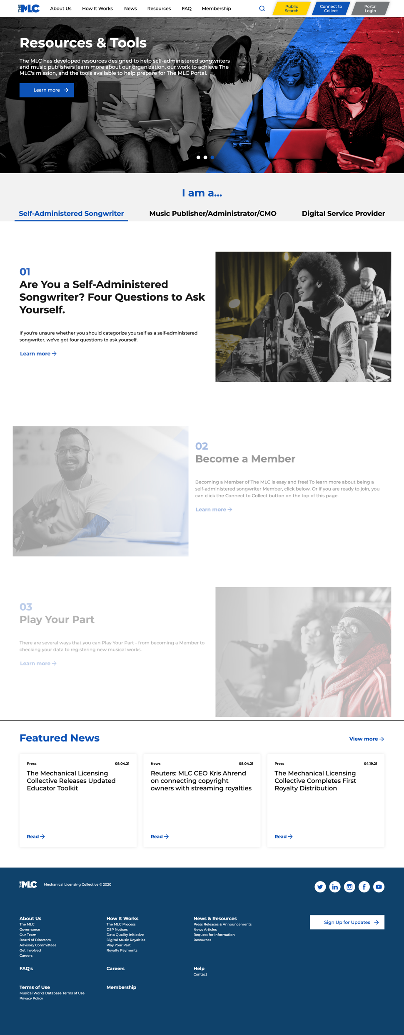
How To Become a Member?
Membership
is Free!
DSPs pay 100% of The MLC’s operating costs.
This allows The MLC to distribute 100% of the royalties we receive
without deducting any administration fees
Notes:
It is very easy to become a member. There is a Connect to Collect button at the top right on our website where the process is kicked off.
Membership is free, and in fact The MLC does not take an administrative fee out of the royalties we collect to pay for our operating expenses. The copyright law requires the digital music services to pay for the cost of operating the MLC.
That means that the MLC can distribute 100% of the royalties it receives to its Members.

Slide 17



Member Tools
Play Your Part™ by making sure your data is accurate so that you are paid for uses of your songs. Nobody know your data better than you!
Play Your Part™ = Register the Works you administer
REGISTER YOUR WORKS
MATCH YOUR WORKS
Claim Your Share
Add Works
Match to Recordings
Members can search our database to find their works and claim their share using our Claiming Tool
Members can add their works and claims to our database using our portal screens, uploading a spreadsheet, or
sending a CWR file*
Members can match their works to related sound recordings using our
Matching Tool
Notes:
After becoming a Member of The MLC, Members need to register their musical works data with us.
Play Your Part is our catch phrase for this activity.
Members can search our database to see if we already have some data about their musical works, and complete or correct the data. They can also add new works from scratch using a variety of tools.
Members also have the opportunity to search sound recording usage data reported to The MLC by the digital services to recommend matches of the sound recordings to their works.

Slide 18
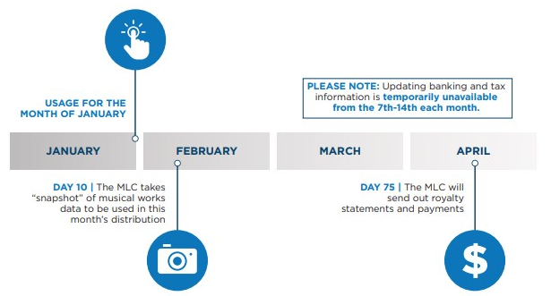
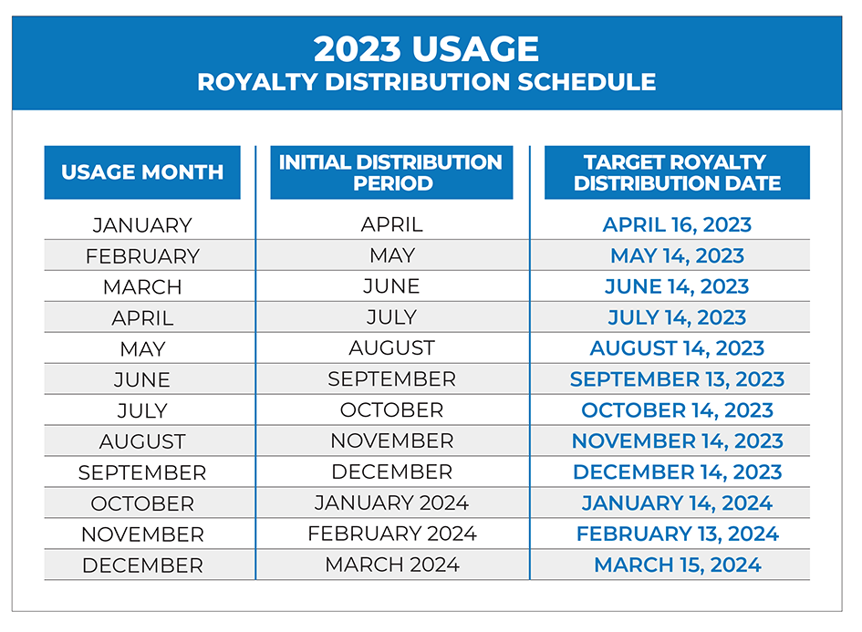
Royalty Distribution Timeline
Timing & Cadence of Royalty Payments
Monthly
75 days after the end of the month
when the activity took place
Notes:
Members get paid royalties on a monthly basis, 75 days after the end of the month the usage activity took place.
For example, a stream that takes place in January would be paid on the royalty statement issued in mid-April.
In order for the use of a musical work to be paid on this timeline, the musical work information has to be set up by the 10th day of the month following the activity.
If that date is missed, once the work is set up, the prior period royalties will be included in the next 75-day royalty statement process.
Eventually but not sooner than three years or so from when the activity took place, royalties which have remained unclaimed will be put into a pool of royalties that will be distributed to Members on a pro-rated basis. More information on how that process will work will be published by The MLC as we get closer to that distribution.

Slide 19
Statutory Royalty Rates
Set by CRB
Phono IV (2023-2027)
Found in 37 CFR Part 385
Ringtones
$0.24 per copy made
Physical +
Permanent Downloads
2023 = $0.12 or $0.0231 per minute of playing time or fraction thereof, whichever is higher, per copy made
Goes up each year based on the Consumer Price Index for All Urban Consumers
Interactive Streaming
(including Limited Downloads)
4-step multi-prong formula
Headline rates: % of revenue, with minimums applied
2023 = 15.1% 2024 = 15.2%
2025 = 15.25% 2026 = 15.30%
2027 = 15.35%
Notes:
The royalty rates used by The MLC are called Statutory Royalty Rates and are set by the Copyright Royalty Board.
The rates are set for a 5-year period, and each rate period is given a short name to make it easy to refer to. The Phono IV period applies to 2023-2027.
The rates are found in the Code of Federal Regulations (CFR) at 37 CFR Part 385
Let me give you a hint on the math. If you are calculating the statutory rate for a recording of a song, anything 5 minutes or less is 12 cents. If it is 5 minutes or longer you have to round up to the next minute and multiply by .0231. If you had a recording that was 5 minutes and 5 seconds long, you would round up to 6 minutes and then multiple 6 times .0231 to get to 13.86 cents as the rate. If a recording was 10 minutes long, you have to multiply 10 by .0231 to get the rate.
The rate for ringtones is 24 cents per copy made
The rate for interactive streaming involves a 4-step multi-prong formula. That formula uses something called the Headline Rates which are a percentage of revenue that the digital service collects with certain minimums applied. The headline rate for 2023 is 15.1% of revenue, which goes up over time to 15.35% in 2027. Let’s take a closer look at these rates.

Slide 20
Statutory Royalty Rates
Interactive Streaming
(including Limited Downloads)
4-Step Formula
Applied Each Month
To Each Offering on a DSP
Examples
Spotify: April Subscription
Spotify: April Ad-Supported
Apple Music: April Subscription
Step 1
Step 2
Step 3
Step 4
Determine Total Royalty Pool for Musical Works
Subtract Performance Royalties
Finalize Mechanical Royalty Pool
Calculate Per Stream Rate and apply to each Work
Notes:
The 4-step formula is applied each month to each offering on a DSP
For example, when you apply the formula to Spotify for its April subscription offering, you get a different result than for its ad-supported offering, which is also different from the Apple Music April subscription offering. That is because the formula uses the amount of revenue generated by the specific service offering for the month as part of the calculation. And the amount will be different for each month for each offering on each service.
In step 1, you determine the total royalty pool for musical works. The total royalty pool includes both performance royalties and mechanical royalties. This this involves a multi-prong calculation, where several values are calculated and compared and one is selected based on the formula rules. One of those prongs involves calculating a percent of revenue using the headline rate.
In step 2, the amount of performance royalties paid to the PROs (like ASCAP and BMI) is subtracted from the total royalty pool for songs.
In step 3, the resulting amount is analyzed, some minimums are potentially applied and the mechanical royalty pool is finalized.
And in step 4, the mechanical royalty pool is divided by the total streams for the month in the offering to get a per stream amount, which is then applied to each work based on how many times it was streamed.
The rate formula is complex and can be confusing. More information can be found on our website and in the Code of Federal Regulations.

Slide 21

Blanket v. Historical Unmatched Royalties
JAN
1
2021
Historical Unmatched Royalties
(HU)
Blanket compulsory mechanical license for digital uses went into effect
Blanket Royalties
(B)
Prior To January 2021
January 2021 and forward
DSPs operated under work-by-work licenses
DSPs began operating under the blanket license
The MLC began collecting royalties due under the blanket license from DSPs
Royalty Distributions
Historical Unmatched royalties were transferred from the DSPs to The MLC in 2021
The MLC began to pay out HU royalties in June 2022
Will continue as the data is prepared, loaded, and matched for each DSP
Royalty Distributions
The MLC began to pay out Blanket royalties in April 2021
Distribution occurs on a monthly basis, 75 days after each usage period
More information about Historical Unmatched Royalties is available on our website www.themlc.com
under How It Works, then Historical Unmatched Royalties
Notes:
On January 1, 2021, the new blanket compulsory mechanical license for digital uses went into effect. That date has created a sort of dividing line in terms of royalties.
Streaming services have been operating since the mid-2000’s and as I mentioned before, some rightsholders have never received their mechanical royalties for uses of their music on interactive streaming services, under the work-by-work license model.
The MMA gave digital services a legal safe harbor protecting them from being sued for unpaid mechanical royalties so long as they transferred the unpaid royalties they were holding as of December 31, 2020 and the related data, to The MLC.
In 2021, The MLC received $424 million dollars of what is called Historical Unmatched royalties, along with more than 4,000 data files. Since then, The MLC has been cleaning up the data files to get them loaded and processed through our systems, matched, and paid out.
Payouts started in the summer of 2022 and continue every month. On royalty statements, royalties are labeled as either Historical Unmatched or Blanket Royalties and include the month the activity took place.
There is an entire page on our website dedicated to explaining this topic.

Slide 22









For more information, please visit: www.TheMLC.com
www.TheMLC.com
The Mechanical Licensing Collective
@MLC_US
@MLC_US
@MLC.US
The MLC
Facebook | @MLC.US
Twitter and Instagram | @MLC_US
LinkedIn | The Mechanical Licensing Collective
Notes:
For more information about The MLC, visit the website at www.themlc.com.
And keep in touch with us to learn about upcoming webinars and events by following us on social media.
Help us spread the word to songwriters, composers, and lyricists so they can make sure they are collecting their digital mechanicals, either directly from The MLC or through their publisher or administrator.

